Slide 1

The Formula of Vision

Slide 2

The Formula of Vision:
Capitalize on the Common Denominator
Pastors all over the world are seeking to find a perfect vision for carrying out The Great Commission in their respective settings.
When you Capitalize on Your Common Denominator you take a step towards unveiling God’s vision for your church to reach your city.

Slide 3
The Great Commission
The words mission and vision are often confusing.
  Mission defines WHY your church exists.
  Vision defines HOW you will fulfill the mission.
Your church’s mission has already been established:
    “Therefore go and make disciples of all nations, baptizing them in the name of the Father and of the Son and of the Holy Spirit.” - Matthew 28:19

Slide 4
Vision Starts with Mission
Your church’s vision must reflect these three elements given to us in Matthew 28:19:
    Go - OUTREACH
    Baptize - WORSHIP EXPERIENCE (FOR LIFE CHANGE)
    Disciple - CONNECTION

Slide 5
The Difference Vision Makes
          Without Vision With Vision
Various wins are celebrated Everyone celebrates the same wins
Inward focused Outward focused
Maintenance focused Growth focused
Spectators Participators
Change is life-threatening Change is necessary to meet goals

Slide 6
The Vision Caster
The role of the senior pastor has drastically changed since the 1960’s. At that time, the congregation’s expectations centered around the pastor’s preaching and care. Those elements are still vitally important, but today, senior pastors must be focused on being proactive in leadership development, vision casting and keeping the church centered on mission.

Slide 7
Defining Your Vision
Vision is how your church is uniquely equipped, empowered, and resourced to accomplish the mission.
    Vision is not just a slogan.
    Vision is not just a list of specific goals.
    Vision is not assumed - people must be compelled to move toward it.
    Vision is not self sustaining- it will not continue if you walk away from it.

Slide 8
The Search for Uniqueness Begins with
Discovering DNA
Every church and leader represent a combination of passions and personalities that are as unique as the strands of DNA which make up the human body.

Slide 9
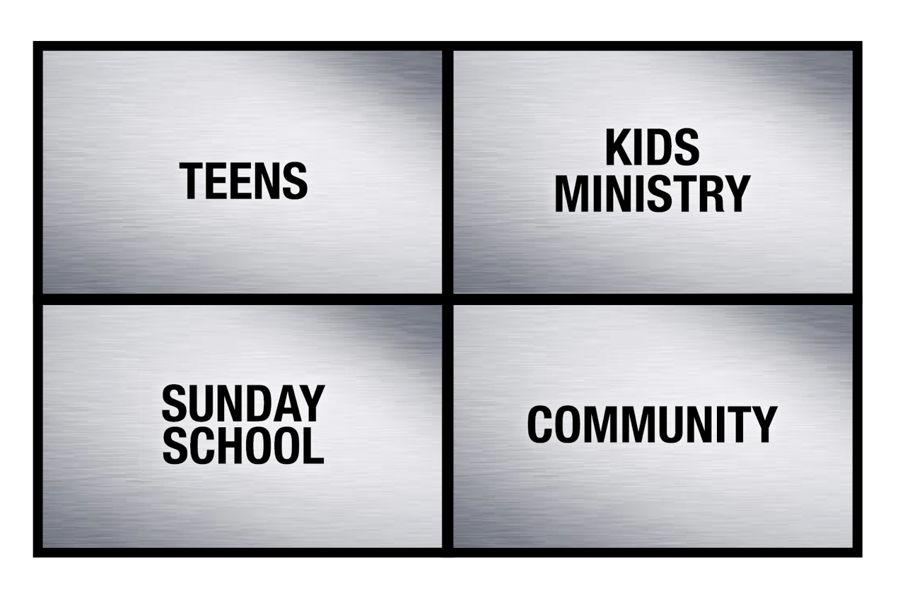
The Church’s DNA
To consider the past and present of your church, look at the church’s DNA:
Kid’s Ministry
Sunday School
Community

Slide 10
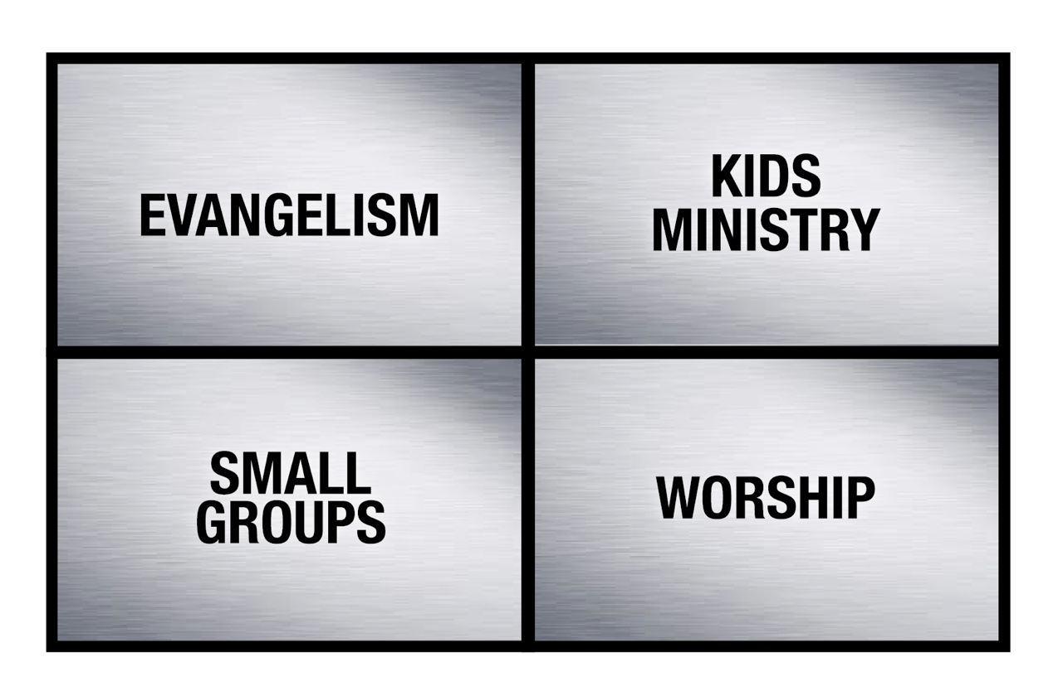
The Pastor’s DNA
To consider the future of your church, look at the pastor’s DNA:

Slide 11
Capitalize on the Common Denominator
The pastor’s and the church’s DNA are not likely to be a perfect match:
Church
Pastor

Slide 12

Capitalize on the Common Denominator
Start where you agree:
Church
Pastor

Slide 13
Discovering Vision
Reasons to consider a new vision statement at your church:
            Perhaps the existing vision is still in tact, but there is just no passion or involvement.
        Would a new vision statement encourage more of the church to be involved?
Would a new vision statement create excitement in the church?
Has the excitement for the existing vision statement dwindled?

Slide 14
Discovering Vision
Step 1: Prayer
Step 2: Dreaming
Step 3: Researching
Step 4: Brainstorming
Step 5: Challenging

Slide 15
Communicating the Vision
Vision must be memorable, motivating, and mobilizing.
Practical ideas for distinguishing vision through branding:
Graphics
Language
Environments
Simplicity

Slide 16
Celebrating the Vision
Celebrate vision through repetition:
Preaching your vision
Tying programming to vision
Celebrate vision

Slide 18
Directing Vision
            White Board
Practical Steps for Directing Vision:
Create a not-to-do list
Resources
Calendar
Relationships

Slide 19
Delegating Vision
            White Board
Practical Steps for Directing Vision:
Through your leaders - the Vision must extend beyond yourself
Through evaluation
Through modeling
Through measurement

Slide 20
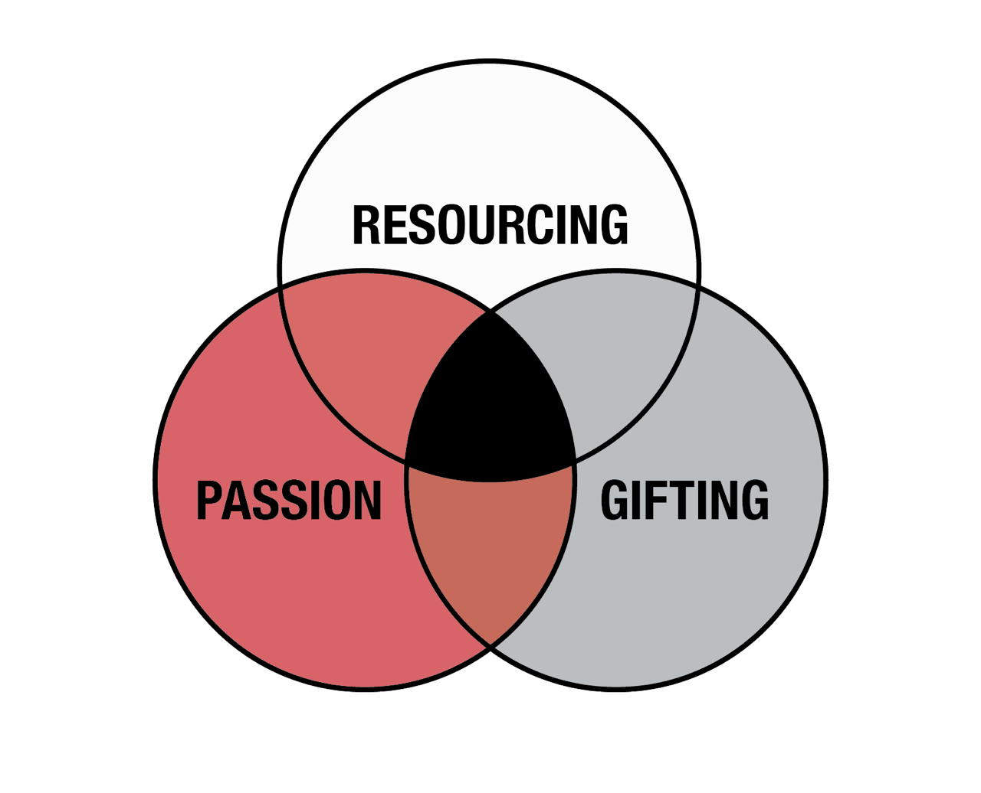
Defining Vision (The Hedgehog Concept)
            White Board
A first step for defining vision in your church is often to utilize a business principle.

Slide 21
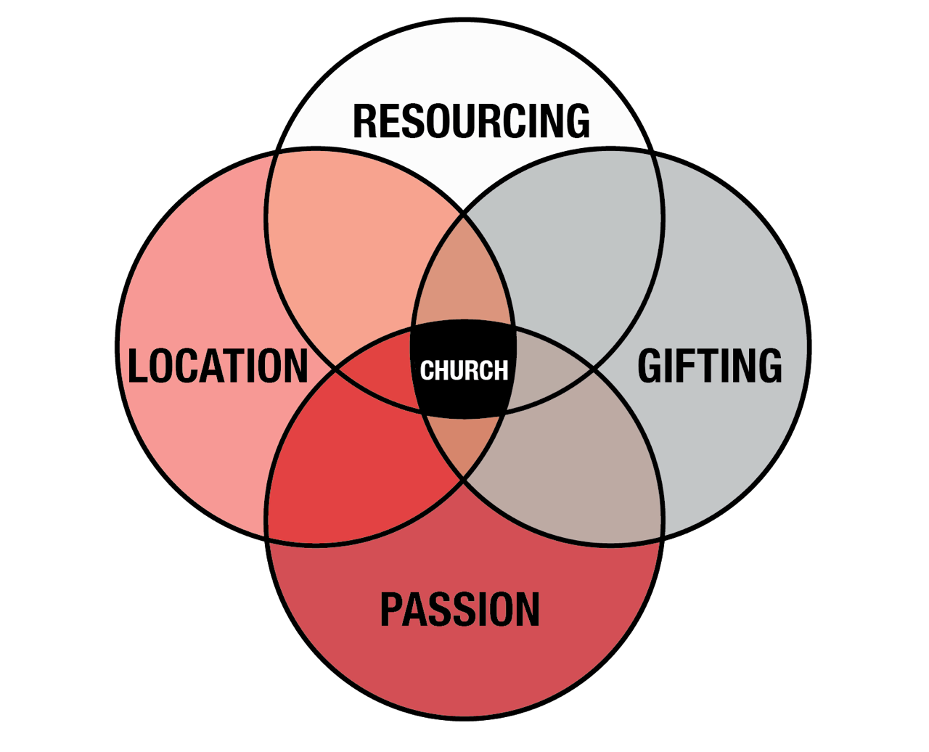
Discovering Vision (The Church Concept)
White Board
Find the common threads through all of these areas to focus your church’s vision:
  PASSION - What are people excited about?
  GIFTING - What can we be the best at?
  RESOURCING - Where are we best
    resourced to actually grow?
  LOCATION - What are the needs of
                our area?

Slide 22
Text

Slide 23
The Formula of Vision:
Lab
Checklist:
Schedule a private prayer day (concerning key demographic and overall vision) AND a sit down with key leaders for a
dream session for where your church could be in 5-7 years.
Read Good To Great by Jim Collins OR Making Vision Stick by Andy Stanley
Meet weekly (for 6 weeks) with your team to brainstorm how to align and communicate your vision.
Discussion Questions:
? List 10 reasons why people should attend our church...
? How would aligning your church’s schedule, resources, energy, etc. with your church’s vision change the way the church
functions?
? Are there any areas of ministry in your church where your (the pastor’s) interests and the church’s interests are aligned
but there is still no progress?
Tool:

