Slide 1
The Formula of Vision
Leader’s Notes

Slide 2
The Formula of Vision:
Capitalize On The Common Denominator
Pastors all over the world are seeking to find a perfect vision for carrying out The Great Commission in their settings.
When you Capitalize On The Common Denominator you take a step towards unveiling God’s vision for your church to reach your city.
“Where there is no vision the people perish.” - Proverbs 29:18
( Message - If people can’t see what God is doing, they will stumble all over themselves.)

Slide 3
The Great Commission
The words vision and mission are often confusing. Here’s how we’ll define the two for our purposes today:
The words mission and vision are often confusing.
Mission defines WHY your church exists.
Vision defines HOW you will fulfill the mission.
“If your mission is unclear, your morale will be low.” - Rick Warren
“Therefore go and make disciples of all nations, baptizing them in the name of the Father and of the Son and of the Holy Spirit.” - Matthew 28:19

Slide 4
Vision Starts with Mission
Your church’s vision must reflect these three elements given to us in Matthew 28:19:
Go - OUTREACH
“It must be the goal of every pastor to reach as many people for Christ as possible.”
- Owen Weston
Baptize - WORSHIP EXPERIENCE (FOR LIFE CHANGE)
Disciple - CONNECTION
In our culture, your church will operate by OUTREACH, WORSHIP, and CONNECTION--to be a growing and healthy church, your vision must reflect the 3 elements...

Slide 5
The Difference Vision Makes
Vision has been a difficult topic for many people to understand and use. It is often seen as an ambiguous, hard to clarify, attribute that some churches value and others misunderstand. When comparing organizations side by side vision is often easier to grasp in practical matters.
Without Vision With Vision
Various wins are celebrated Everyone celebrates the same wins
Inward focused Outward focused
Maintenance focused Growth focused
Spectators Participators
Change is life-threatening Change is necessary to meet goals
The role of the pastor has changed from the 1960’s. At this time a congregation’s expectations centered around the pastor’s preaching and pastoral care. “Today the senior pastor must be focused on being proactive in leadership, vision casting and centered on mission.”
- Net Fax, “Helping Church Leaders Make the Transition from the Present to the Future,”
Number 80, September 15, 1997)

Slide 6
The Vision Caster
The role of the senior pastor has drastically changed since the 1960’s. At that time, the congregation’s expectations centered around the pastor’s preaching and care. Those elements are still vitally important, but today, senior pastors must be focused on being proactive in leadership development, vision casting and keeping the church centered on mission.

Slide 7
Defining Your Vision
Vision is how your church is uniquely equipped, empowered, and resourced to accomplish the mission.
“The starting point for every church should be the question, ‘Why do we exist?’”
- Rick Warren
Vision is not just a slogan
Vision is not just a list of specific goals
Requires goals to ensure it’s continued quality.
Vision is not assumed - people must be compelled to move toward it.
You have to compel people to move in the direction of the vision.
Vision is not self-sustaining—it will not continue if you walk away.
Vision is not self sustaining - it will not continue if you walk away from it.

Slide 8
The Search Uniqueness Begins with Discovering DNA
Often pastors or leaders are frustrated when they don’t see people getting on board with their vision.
A common misunderstanding that we must address is that you don’t take a vision to a church--you will be more effective if you find the common denominator between your vision and the church’s and capitalize on it.
Every church and leader represent a combination of passions and personality that are as unique as the strands of DNA that make up the human body.
“You can't manufacture passion or ‘motivate’ people to feel passionate. You can only discover what ignites your passion and the passions of those around you.
those things that we can get passionate about.” - Jim Collins

Slide 9
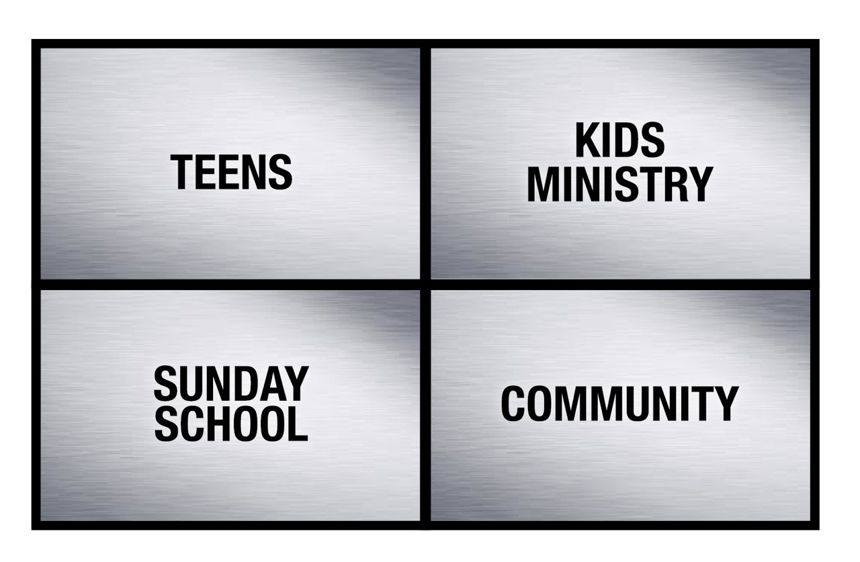
The Church’s DNA
To consider the past and present of your church, look at the church’s DNA:
Let’s use this church as an example, these four blocks represent the areas the church has been and is most passionate about. These are the areas they look for and
fight for.
Research indicates that the average pastor’s tenure is less than 3 years, thus the church’s interests often trump those of the pastor.
Often your position of leadership does not compel your congregation to take on your interests.

Slide 10
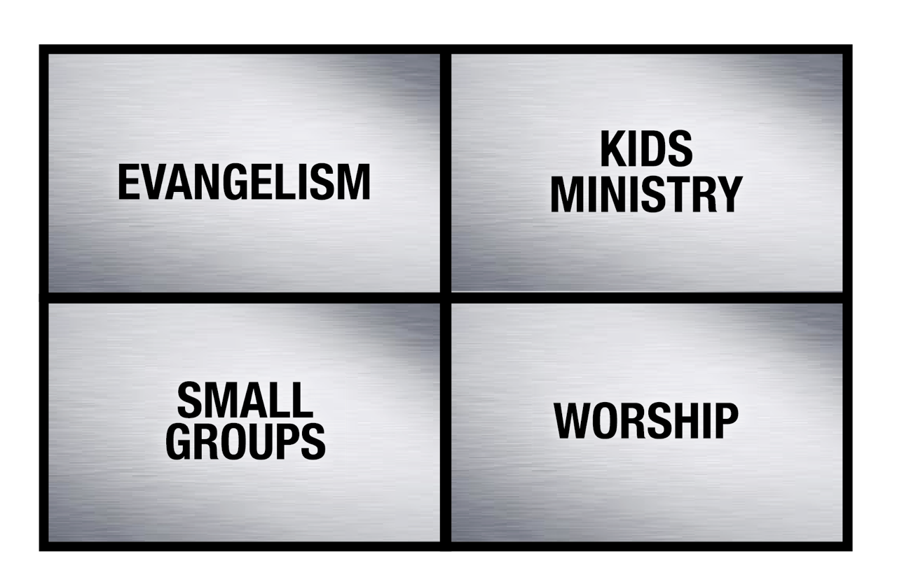
The Pastor’s DNA
“People don’t buy into visions; they buy into a leader.” - John Maxwell
To consider the future of your church, look at the pastor’s DNA:
These four blocks represent the areas the Pastor is most passionate about.
“Culture is a product of leadership. Having a church culture is not optional. You will have one. You can either be intentional and purpose driven about what kind of culture you create, or you can just let ‘what will be will be.’" - Robert Morris

Slide 11
Capitalize On The Common Denominator
The pastor’s and the church’s DNA are not likely to be a perfect match:
If a pastor, whose number ONE priority is Evangelism walks into a church where the established number ONE priority is Teens and tries to establish Evangelism as the new number ONE priority, he will likely face a great deal of resistance.
Church
Pastor

Slide 12
Capitalize On The Common Denominator
Early in your influence you should focus on areas that both you and the church are passionate about. This is the quickest way to gain momentum.
Start where you agree:
“I often advise leaders to spend less time trying to fix problems and more trying to create momentum.” - John Maxwell
Over time, as you gain influence your interests will become their interests.

Slide 13
Discovering Vision
“You may be thinking, ‘We already have an existing vision.” After 15 years of existence most churches will be in a dying phase.” - Owen Weston
Vision counteracts stagnation. Vision is the catalyst for movement.
Reasons to consider a new vision statement at your church:
Perhaps the existing vision is still in tact, but there is just no passion or involvement.
Would a new vision statement encourage more of the church to be involved?
Would a new vision statement create excitement in the church?
Has the excitement for the existing vision statement dwindled?
- Do your efforts focus more on equipping people or meeting their needs?
- If everything worked out perfectly for your church, where would you be in 3 years?
- What do you find yourself praying about the most (who’s here or who’s not)?

Slide 14
Discovering Vision
No matter what path you take to discovering or implementing your church’s unique vision for ministry, start with these 4 steps.
Step 1: Prayer
Proverbs 16:9 We can make our plans, but the Lord determines our steps. (NLT)
Step 2: Dreaming
Don’t have such a small vision that God doesn’t need to be involved.
Step 3: Researching
Step 4: Brainstorming
Ex. think tanks, demographic study, prayer exercises, research other churches, etc.
Step 5: Challenging
Your vision will need to be tested and challenged. Discovering and implementing vision in a local church is a process, not just a once and for all decision.
An interesting point in all of this is that Nehemiah spent the first 3 days after he entered Jerusalem in total silence. He spent 3 days in total silence - what was he doing? He was evaluating the situation. The bible says that he rode around the city looking at the situation.

Slide 15
Communicating the Vision
Vision must be memorable, motivating, and mobilizing.
“First, if your vision is going to stick in people's minds, it must be memorable.” - Andy Stanley
Great services are important but you better have a vision that causes people to move to their next step (or you’ll never grow) - this is why vision is so vital.
Practical ideas for distinguishing vision through your brand:
Graphics
“Vision, mission, and purpose documents are all created for an internal audience. A church slogan or positioning statement is created for an external audience - the community around you. Such a slogan is less about leadership and more about marketing.” - Robert Morris
Language
“If the process is not clearly defined so that everyone is speaking the same language, there is confusion and frustration.” -Simple Church (Thom Rainer & Eric Geiger)
Environments
If your vision targets young families then your environments should be designed with them in mind.
Simplicity
“It is better to have a vision statement that is incomplete and memorable than to have one that is complete and forgettable.” - Andy Stanley
“If the vision is too complicated for people to embrace, nothing changes.” - Andy Stanley
“To have a simple church, leaders must ensure that everything their church does fits together to produce life change. They must design a simple process that pulls everything together, a simple process that moves people toward spiritual maturity.”
-Simple Church (Thom Rainer & Eric Geiger)

Slide 16
Celebrating the Vision
Celebration vision through repetition:
“Casting a convincing vision once is not enough to make it stick. Twice isn't enough either. Vision needs to be repeated regularly.”
- Andy Stanley
Visionary leaders will tell you when you get tired of saying something the people you are leading are just now getting it.
Preaching your vision
“Vision should evoke emotion. And it's difficult to evoke emotion with an e-mail or a letter.” - Andy Stanely
“Preaching is perhaps the most important vision casting tool a pastor has at his disposal.” - Osborne
Tying programming to vision
“Alignment is the arrangement of all ministries and staff around the same simple process.” - Simple Church (Thom Rainer & Eric Geiger)
“Alignment to the process means that all ministry departments submit and attach themselves to the same overarching process.” - Simple Church (Thom Rainer & Eric Geiger)
Celebrate vision
“Psychologists tell us that what gets rewarded gets repeated. When someone brings a guest, celebrate with him.” - Nelson Searcy
“Every organization celebrates something. But if your vision doesn't align with your celebrations, I assure you that what's celebrated will overpower the vision and determine the course of your organization.” - Andy Stanley
“A built-in time to celebrate a win in our organization is during baptisms on Sunday mornings. I'm convinced that our baptisms do more to drive home our vision than anything else we do.” - Andy Stanley

Slide 18
Directing Vision - (Alignment)
White Board
Once you have a vision, you have to decide how it applies to your organization in a practical way.
“The vision of an organization acts as its magnetic north. “ - The Leadership Challenge
The way to build a bridge to the future is by creating GOALS and TASKS that carry the church toward the vision you feel God has given your church.
Practical Steps for Directing Vision:
Create a not-to-do list
“Churches are notorious for creating competing systems, wherein unclear direction and conflicting information threaten to cause a breakdown and paralyze ministry. Instead of replacing old systems, we tend to just download and add whatever is new to what already exists.” - Andy Stanley
“Create a "not-to-do" list outlining programs your organization SHOULDN'T do. In other words, decide now what you will never do.” - Andy Stanley
“If you really want to make a lasting impact, then you need to eliminate what you do WELL for the sake of what you can potentially do BEST.” - Andy Stanley
Resources
“The more programs, the better, or so it seems. Yet in many cases, these programs, which drain the church budget of thousands of dollars and demand thousands of man-hours, do little to produce fruit.” - Gene Wood
Calendar
“Misalignment usually happens gradually. And if it goes unchecked, it can wreak havoc on an organization.”
- Andy Stanley
Relationships
Hire and empower only those people who understand and can implement the vision.

Slide 19
Delegating Vision
White Board
Through your leaders - the vision must extend beyond yourself
“Before the process can be clear to the people in the church, it must first be clear to the leaders.” - Simple Church ( Thom Rainer & Eric Geiger)
“People do not progress through the simple process because they hear it from the pulpit. People do not move through the process because they see a purpose statement on the wall. As helpful as these things can be, people move because someone else brings them through the process.” - Simple Church (Thom Rainer & Eric Geiger)
Through evaluation
“There is no excellence without evaluation.” - Nelson Searcy
Through modeling
“Your willingness to embody the vision of your organization will have a direct impact on your credibility as a leader.” - Andy Stanley
Through measurement
“Vision is the compass by which we steer our spending. It's the yardstick by which we measure our progress. It's the standard by which we evaluate new programs and propose initiatives.” - Robert Morris

Slide 20
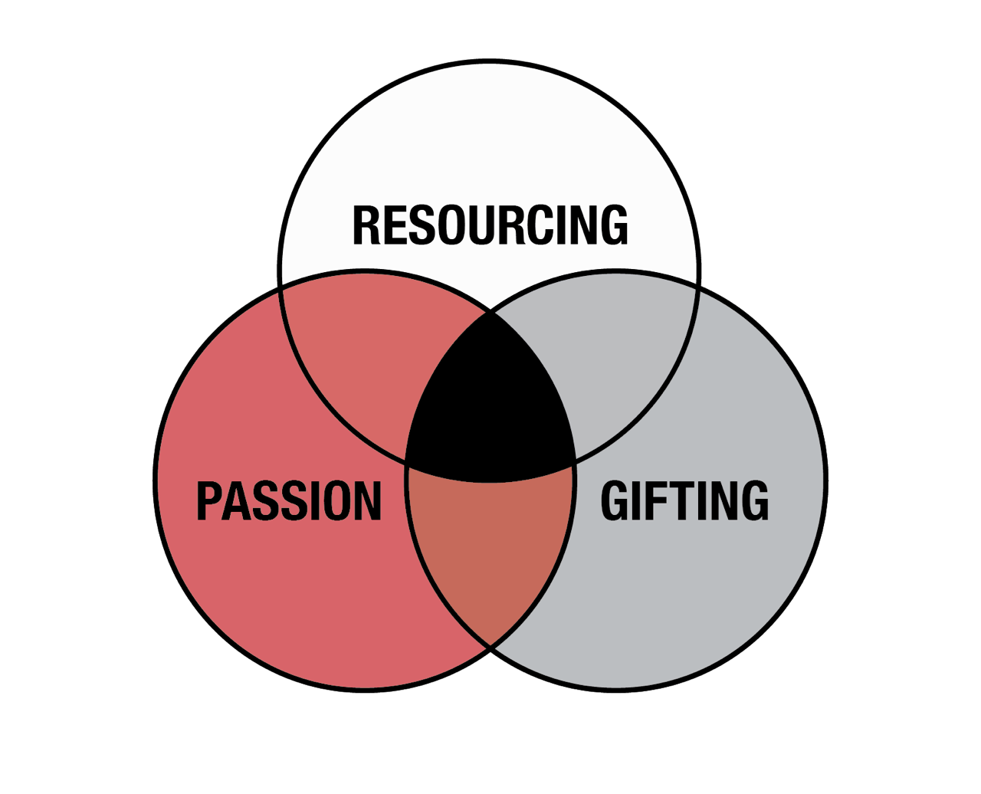
Defining Vision (The Hedgehog Concept)
White Board
A first step for defining vision in your church is often to utilize a business principle.
The Hedgehog Concept - a simple, crystalline concept that flows from deep understanding about the intersection of the following three circles:
(1) What you can be the best in the world at (GIFTING) (and, equally important, what you cannot be the best in the world at),
(2) What drives you economic engine (RESOURCING)
(3) What you are deeply passionate about.
“A Hedgehog Concept is not a goal to be the best, a strategy to be the best, an intention to be the best, a plan to be the best. It is an understanding of what you can be the best at.”
- Jim Collins
See APPENDIX A for further explanations of The Hedgehog Concept.

Slide 21
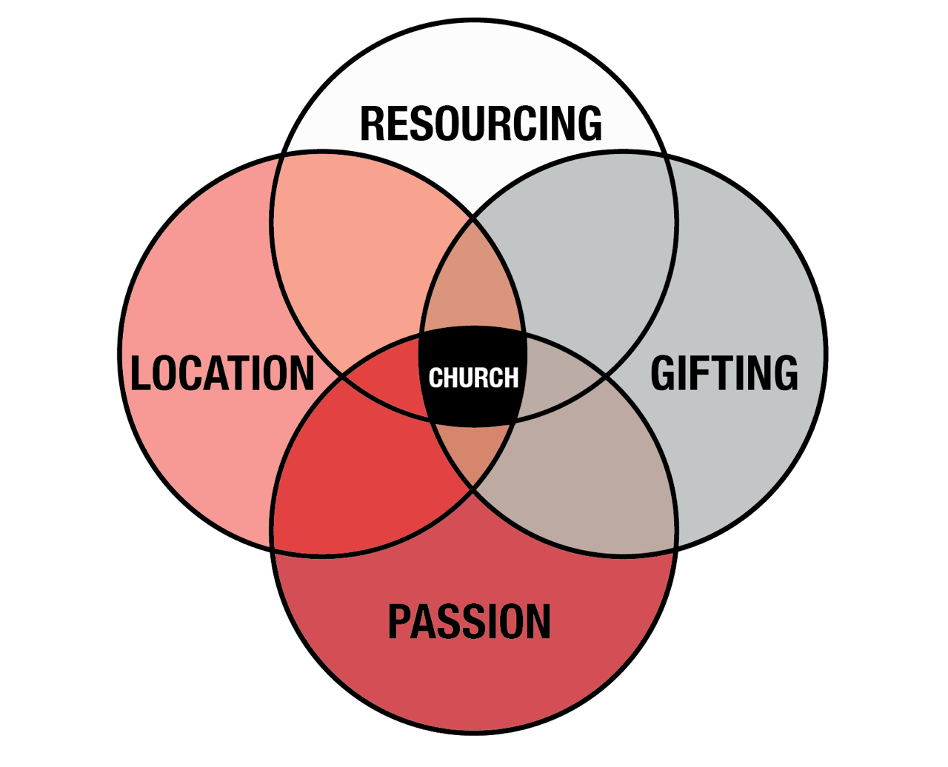
Discovering Vision (The Church Concept)
White Board
Hedgehog is a business concept that we can apply to ministry in your church - 4 blended circles
Find the common threads through all of these areas to focus your church’s vision:
PASSION - What are people excited about?
GIFTING - What can we be the best at?
RESOURCING - Where are we best resourced to
actually grow?
LOCATION - What are the needs of our area?
Example...Passion - an aging church wants to reach their children and grandchildren. Gifting - They have a group of school teachers who are willing to serve and a pastor who doesn’t mind speaking on relevant family issues. Resourcing - They have available budget and space for children’s facilities. Location - They are located in an area where few other churches are targeting young families.

Slide 23
The Formula of Vision:
Lab
Checklist:
Schedule a private prayer day (concerning key demographic and overall vision) AND
a sit down with key leaders for a dream session for where your church could be in 5-7 years.
Read Good To Great by Jim Collins OR Making Vision Stick by Andy Stanley
Meet weekly (for 6 weeks) with your team to brainstorm how to align and
communicate your vision.
Discussion Questions:
? List 10 reasons why people should attend our church...
? How would aligning your church’s schedule, resources, energy, etc. with your church’s
vision change the way the church functions?
? Are there any areas of ministry in your church where your (the pastor’s) interests
and the church’s interests are aligned but there is still no progress?

Slide 25
The Hedgehog Concept
APPENDIX A
“In his famous essay ‘The Hedgehog and the Fox’, Isaiah Berlin says, ‘the fox knows many things, but the hedgehog knows one big thing.’ Foxes pursue many ends at the same time and see the world in all its complexity. They are ‘scattered or diffused, moving on may levels,’ says Berlin, never integrating their thinking into one overall concept or unifying vision. Hedgehogs, on the other hand, simplify a complex world into a single organizing idea, a basic principle or concept that unifies and guides everything. Hedgehogs aren't simpletons. Hedgehogs see what is essential, and ignore the rest.” - JIm Collins
“A Hedgehog Concept simplifies a complex world and make decisions much easier. But while it has crystalline clarity and elegant simplicity once you have it, getting the concept can be devilishly difficult and takes time.” - Jim Collins
“You need all three circles. If you make a lot of money doing things at which you could never be the best, you'll only build a successful company, not a great one. If you become the best at something, you'll never remain on top if you don't have intrinsic passion for what you are doing. Finally, you can be passionate all you want, but if you can't be
the best at it or it doesn't make economic sense, then you might have a lot of fun, but you won't produce great results.” – Jim Collins

